Slide 1
Web Development with MEAN Stack
CS 144 Web Application
TA: Jin Wang
02/16/2018

Slide 2
Schedule of the following weeks
Week 6 Node.js + MongoDB + Express
Week 7 Information Retrieval + Spatial Index
Week 8 MapReduce Programming
Week 9 Security (by Zijun Xue)
Week 10 Final Review

Slide 3
Overview
Overview of Project 4
Express - Node.js framework
Cookie and session

Slide 4
Project 4: Overview
Goal: Develop Server-side APIs for the markdown editor
Tasks:
Access Control
Implement REST APIs
Connect with frontend
Develop Environment
Docker Image
Express-generator
IDE
Note: This part is subject to change! Please refer to the official description posted on course website.

Slide 5
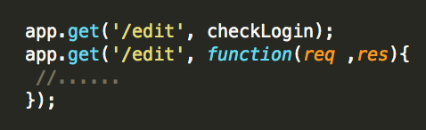
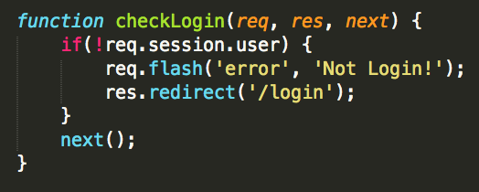
Project 4: Access Control
Add preview page
Show all posts of a user
Show a particular post
Navigation: prev and next buttons
Add user login page
User Input: name and password
Validate using database
Check for authorization

Slide 6
Project 4: Implement REST APIs
The same functionality with Project 2
Server APIs
GET, POST, PUT, DELETE
Example
https://api.github.com/users/hadley/orgs
Detailed explanation of REST API
https://stackoverflow.com/questions/671118/what-exactly-is-restful-programming

Slide 7
Project 4: Connect with Frontend
Rewrite the Blog Service part
Replace operations to local storage with those to MongoDB
Support URL navigation

Slide 8
Project 4: Develop Environment
Express-generator
Install: sudo npm install express-generator –g
Usage: express [option] [project-name]
Run: npm start
IDE: Webstorm
An JavaScript IDE with GUI
https://www.jetbrains.com/webstorm/
Belongs to the family of IntelliJ IDEA
Note: make sure your program also works in the Docker image

Slide 9
Overview
Overview of Project 4
Express - Node.js framework
Cookie and session

Slide 10
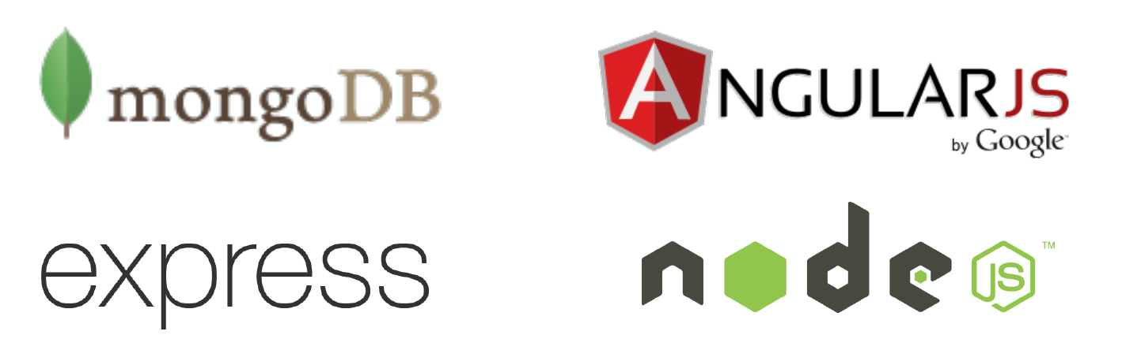
What’s MEAN Stack?
MEAN Stack is a full-stack JavaScript solution that helps you build fast, robust and maintainable production web applications using MongoDB, Express, AngularJS, and Node.js.

Slide 11
Important Programming Issues
Modules
Routing
Asynchronous programming
EJS template
MongoDB connection

Slide 12
Modules: basic
Each file is treated as a module
Predefined: package.json -> dependencies
Require(): load a module
Avoid circular require
It will return empty object {} instead of the actual modules
Example: a->b, b->c, c->a
Exports
The initial value of module.exports is an empty object {}
exports pointed to the reference of module.exports
require() returns module.exports instead of exports

Slide 13
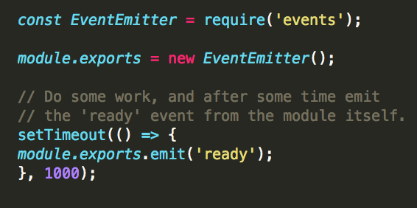
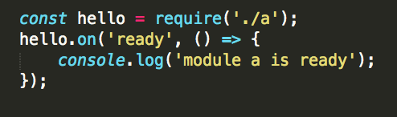
Modules: example
a.js
Export a module
Refer to existing files in
./node_modules/
Tip: can be applied to
database connection and
configuration files
Cannot be done in any callback!
main.js

Slide 14
Routing: basic
Function: app.method(path, handler)
Method: HTTP methods, e.g. get, post, all
Path: route at which the request will run
We can have different functions at the same path.
Handler: a callback function that executes when a matching request type is found on the relevant route
Routers:
Goal: define all routes in a single file, export as a module
Usage: express.Router()

Slide 15
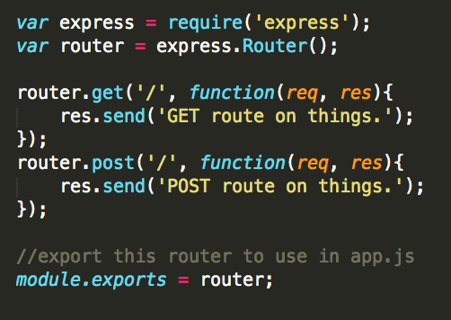
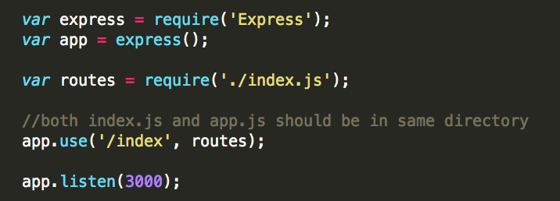
Routing: example
index.js
app.js

Slide 16
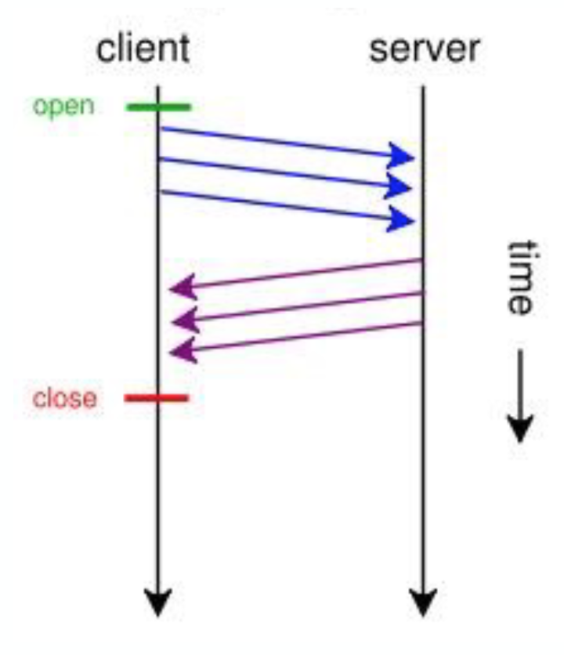
Asynchronous Programming
Calls do not block (or wait) for the call to return from the server.
Execution continues on in your program, and when the call returns from the server, a "callback” function is executed.
Application scenarios: database operations, network communication

Slide 17
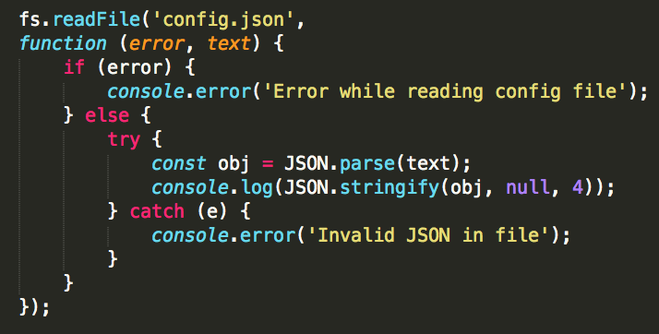
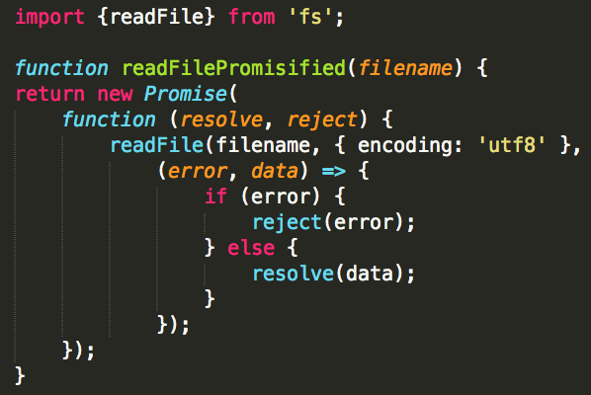
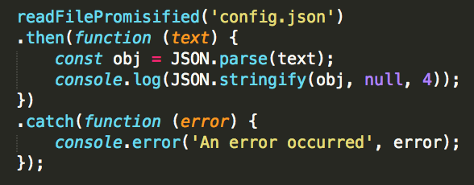
Asynchronous Programming: Example
Task: read file from JSON
Problem: callback hell
Solution: Promise

Slide 18
EJS template
A template to “translate” JavaScript to HTML
Setup in app.js

Slide 19
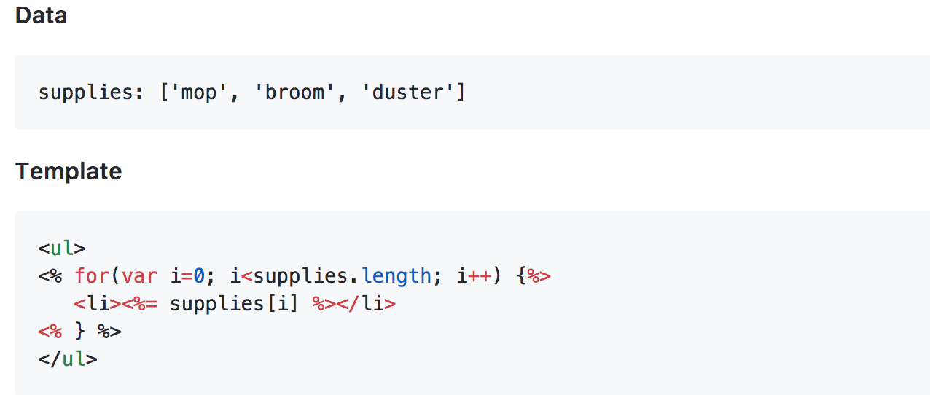
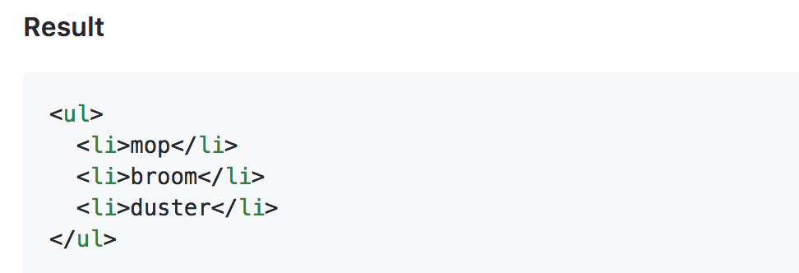
EJS template
Template of <% %>
<% code %> run the JavaScript without output
<%= code %> display the contents after translating to HTML
<%- code %> Show the original HTML contents
Example:

Slide 20
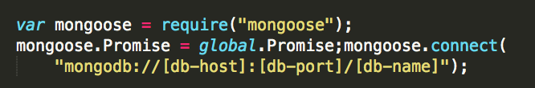
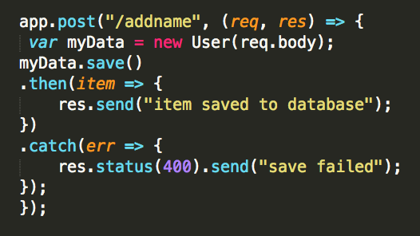
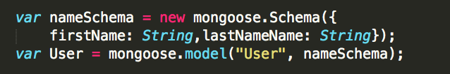
MongoDB connection
User the driver for node.js
Start MongoDB service before launching project!
The mongoose module
Connect to database
Create a database schema and model
Save data to database with REST API
More details: https://www.npmjs.com/package/mongoose

Slide 21
Overview
Overview of Project 4
Express - Node.js framework
Cookie and Session

Slide 22
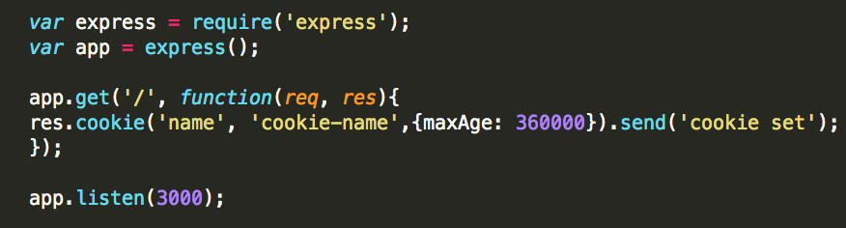
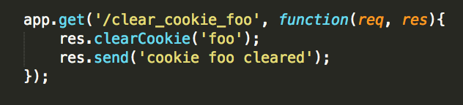
Cookie and Session
Cookie
Simple files sent to client with request, stored in client.
HTTP: no status! Cookie: keep the status
Track user actions
Setup cookies
Delete cookies

Slide 23
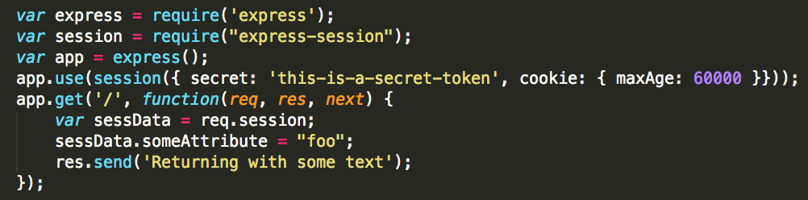
Session
Basic idea
A “buffer” of data that can be accessed across requests
Goal: allow applications to store state
Cookie-session: attach cookie to requests: req.session
Module in Express

Slide 24
Storing Session Data
In application memory
The simplest way
The data stored in the lifetime of application runtime.
Disadvantages:
Failure handling
Memory Leaks

Slide 25
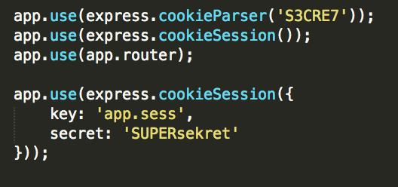
Storing Session Data
In cookies
Idea: use cookie to store session data for different users
Required modules:
Setup:
Disadvantages
Not work well for large, complicated, sensitive data
Limited size of cookies a browser can store

Slide 26
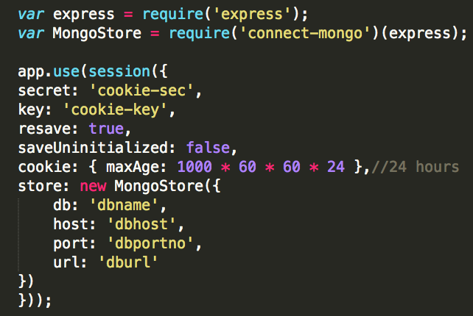
Storing Session Data
In database
MongoStore: use MongoDB to store sessions
Required Module: connect-mongo

Slide 27
Resources
http://expressjs.com/guide.html
http://expressjs.com/api.html
http://github.com/visionmedia/express/tree/master/examples/
https://developer.mozilla.org/en-US/docs/Learn/Server-side/First_steps
https://www.npmjs.com/package/mongodb
http://www.embeddedjs.com/

